Slide 1
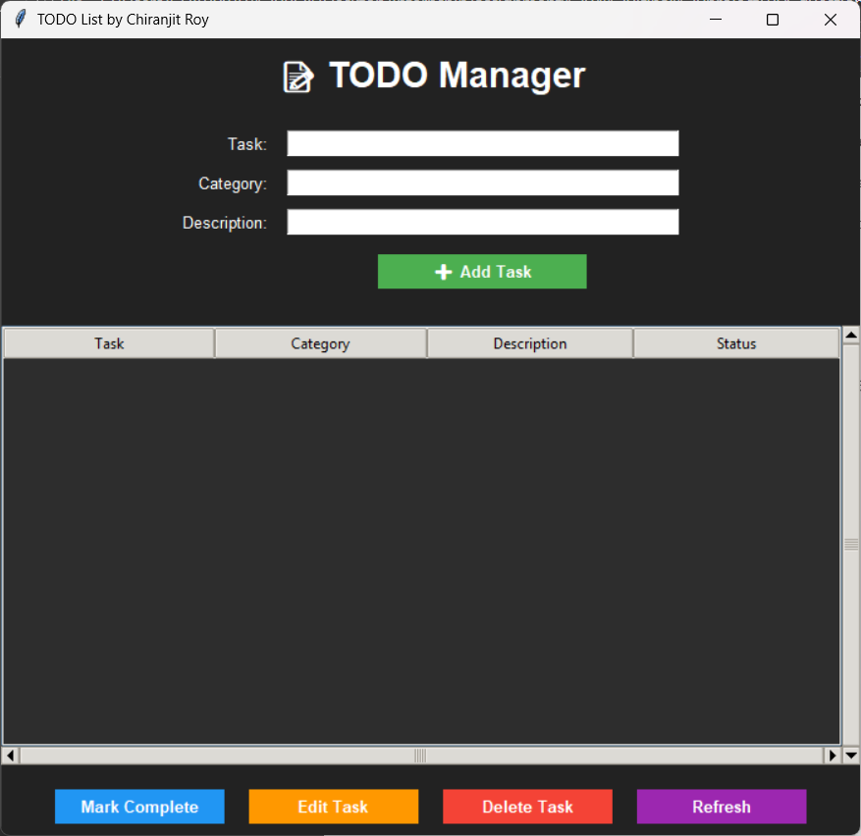
Overview of the software
We can add new task from here
Display section. All the task will be shown here
All the operational button is here

Slide 2

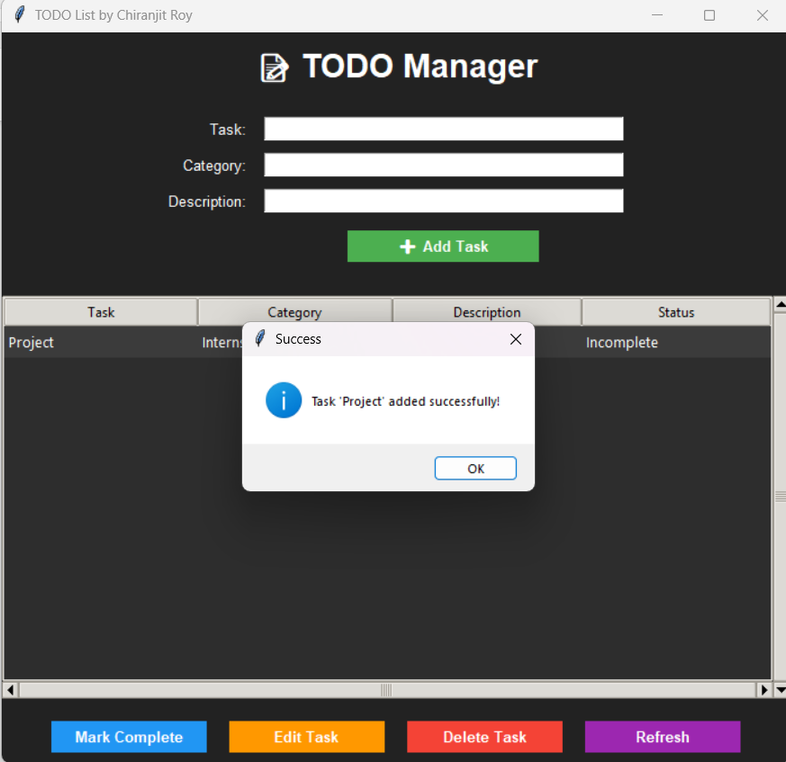

How to add new a task?
Image-1
Image-2
Image-3
Fill all the fields and then “click” on “Add Task” button
“Click” on popup window “OK” button
Added successfully

Slide 3
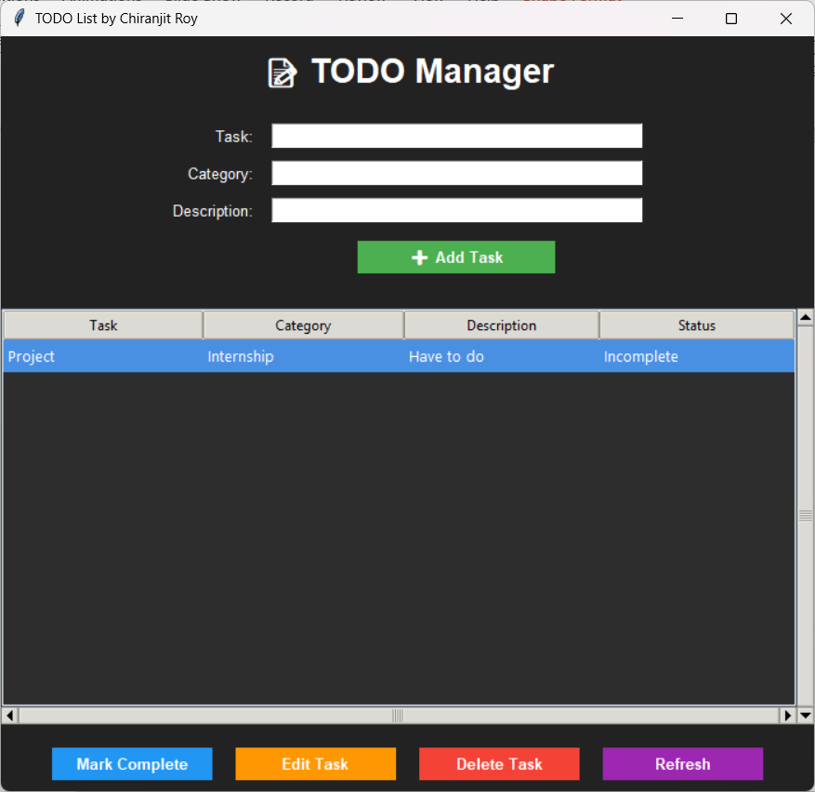
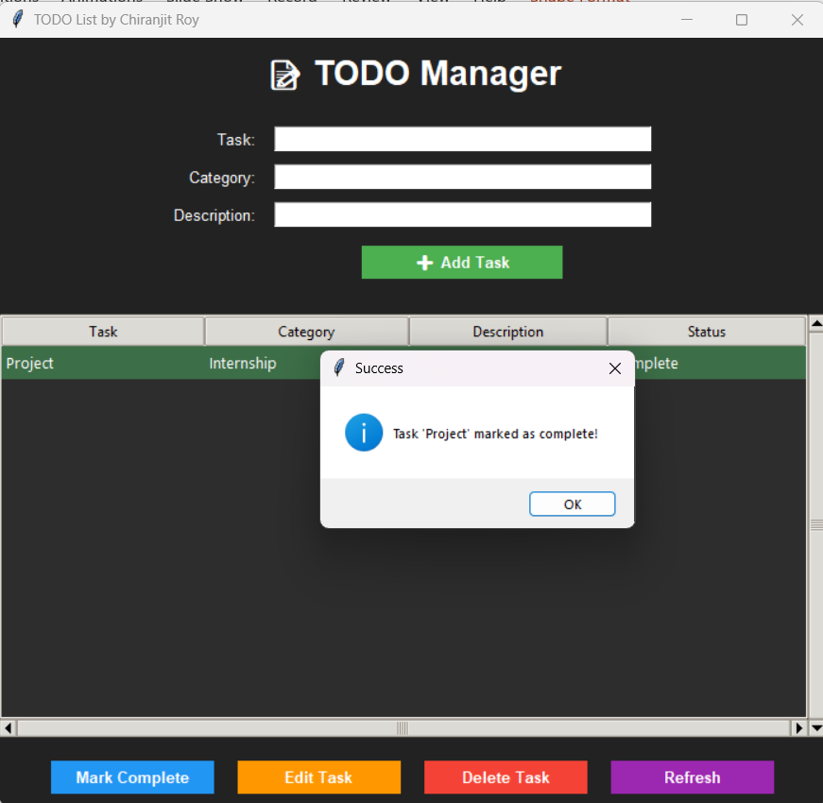
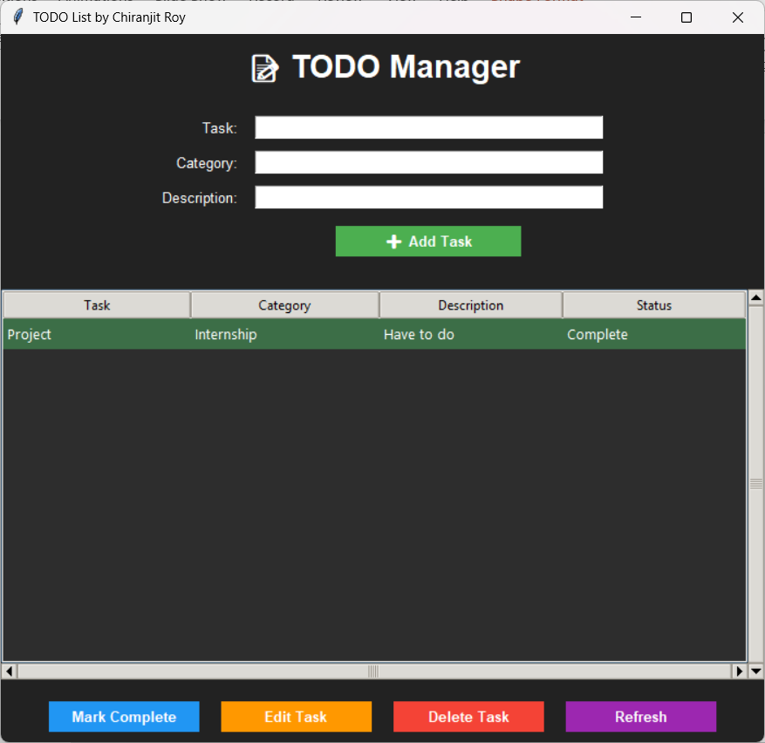
How to mark task as completed?
Image-1
Image-2
Image-3
Select a task then “Click” on “Mark Complete”
“Click” on “Ok” form the popup window
Successfully marked as complete and it’s colour changed into green

Slide 4

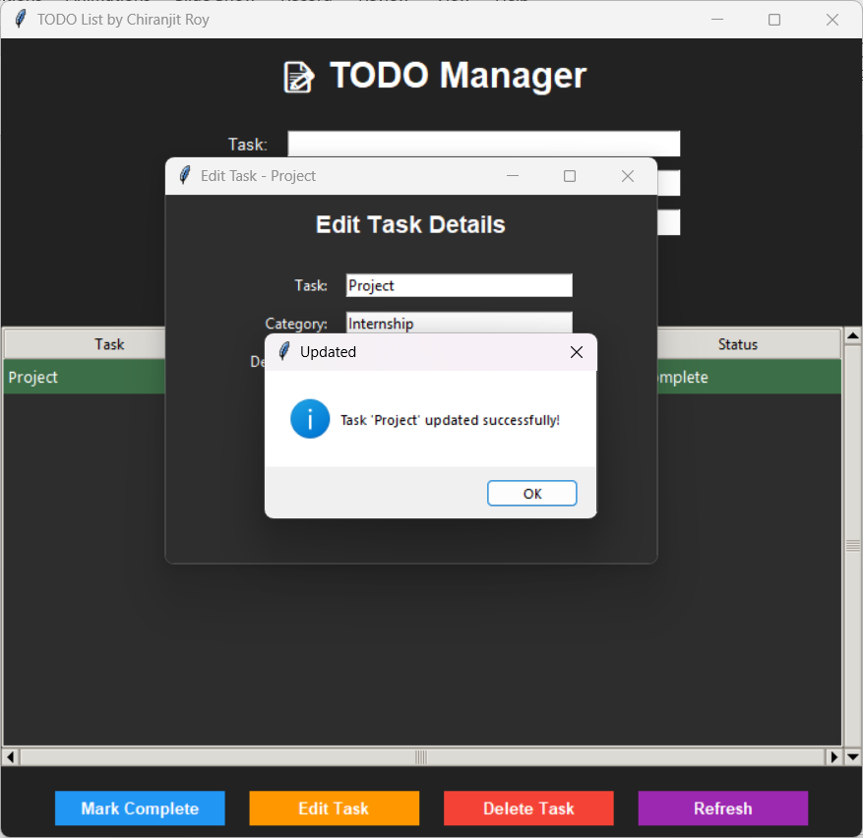
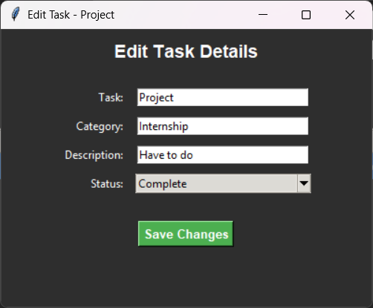
How to edit a task?
Image-1
Image-2
Image-3
Fill all the entries as your wish then “Click” on “Save Changes” button
Finally, “Click” on “Ok” button
Select a task then “Click” on “Edit Task” button

Slide 5

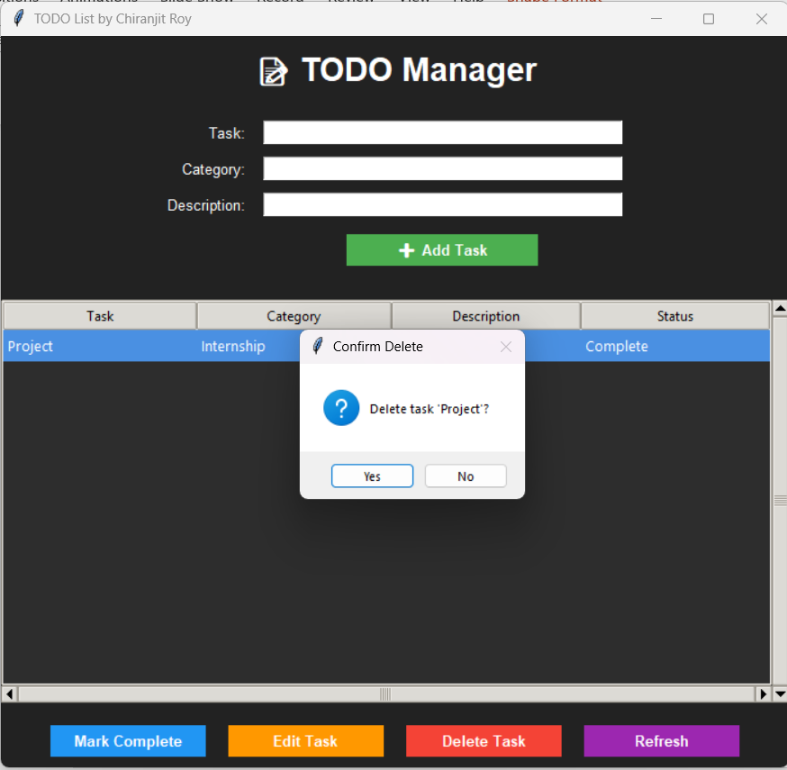
How to delete a task?
Image -1
Image-2
Select a task then “Click” on “Delete Task” button
“Click” on “Yes” button to confirm

Slide 6
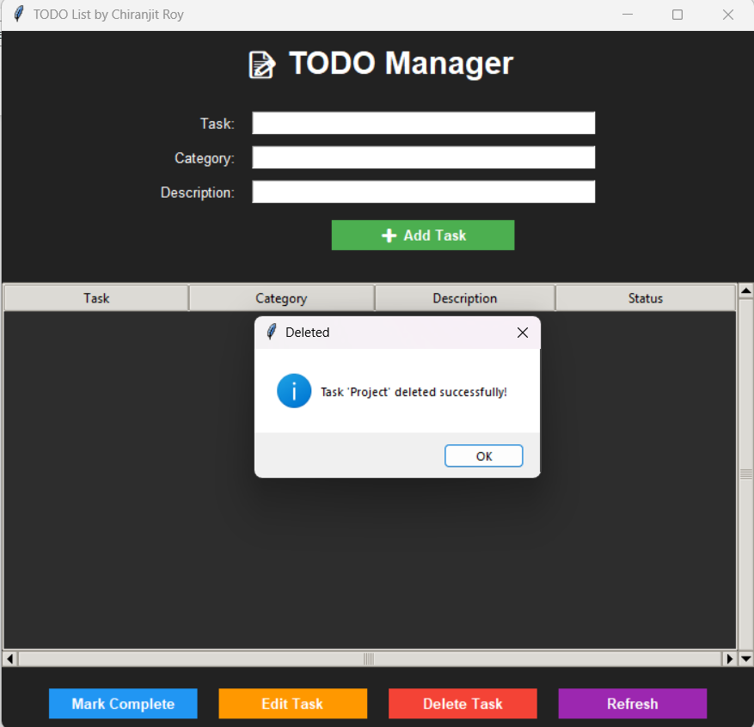
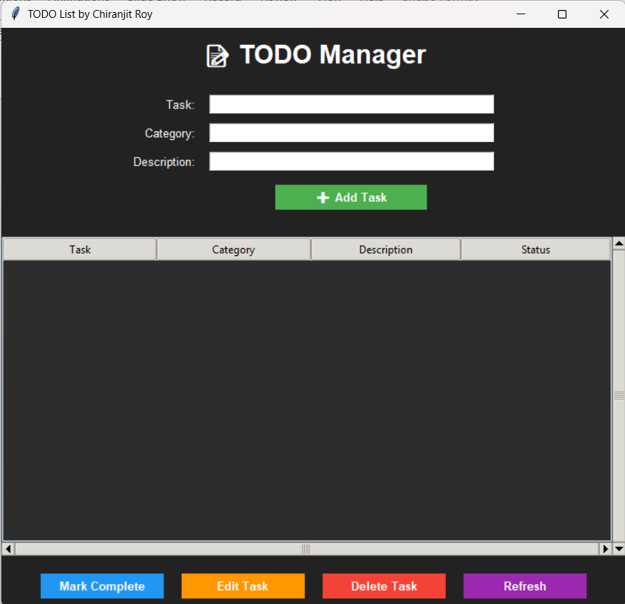
Image-3
Image-4
“Click” on “Ok” button
Successfully deleted

Slide 7

How to deselect a task?
Image-1
Image-2
This task is selected . Now “Click” on “Refresh” button to deselect
Deselection successful

Slide 8
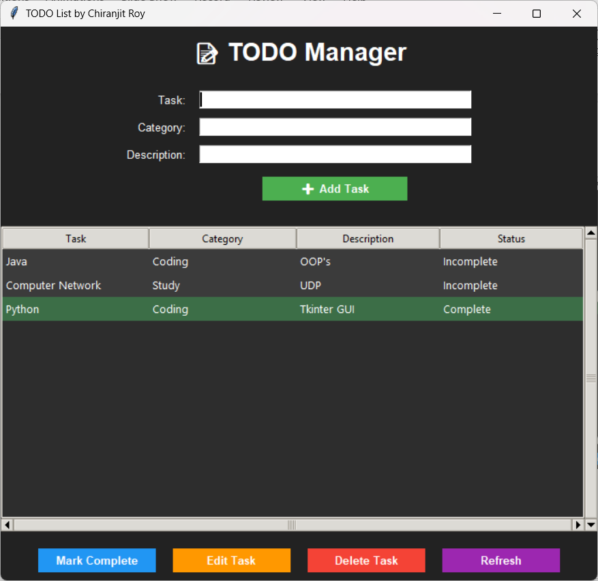
Extra features
As you can see completed task is in the bottom and incomplete tasks are in top
We can do vertical and horizontal scroll using this two-scroll bar

